Slide 1
Welcome to the 2021 University of La Verne College of Law
Barrister’s Ball
Awards Ceremony

Slide 2
Barrister’s Ball Award Winners

Slide 3
Professor of the Year Award
Awarded to a Professor who has demonstrated a commitment to students at the College of Law through his/her teaching, mentorship, and other contributions of their time and talents.

Slide 4
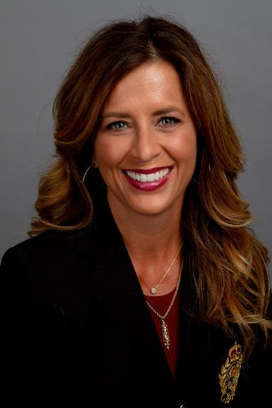
Professor of the Year Award Winner
Professor Michele
Assael-Shafia
“Not only has she kept open communications when it comes to school, but she always encouraged students to be open about any struggles or triumphs they have with life in quarantine to instill a positive environment.

Slide 5
Adjunct Professor of the Year Award
Awarded to an adjunct Professor who has demonstrated a commitment to students at the College of Law through his/her teaching, mentorship, and other contributions of their time and talents.

Slide 6
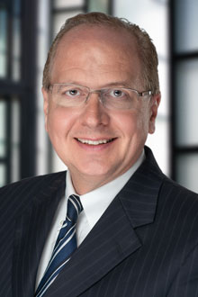
Adjunct Professor of the Year Award Winner
Professor
Dean
McVay
“To give as Dean McVay does, bringing home awards from the local, state, and national level, he instills confidence in future attorneys, and deserves recognition for being as dedicated as he is, regardless of how busy his own successful career as an attorney may be.”

Slide 7
Congratulations to all the Barrister’s Ball Award Winners!

Slide 8
Current SBA Board 2020-2021
President – Michael Chavez
Vice President – Savitri Zala
Secretary – Rosa Trujillo Vasquez
Historian – Arturo Ochoa
ABA Representative – Marcus King
Part-Time Representative – Gabriel Eredia
3L Representative – Sara Martinez
2L Representative – Samantha Walker
1L Representative – Shalini Quattlebaum

Slide 9
Now Presenting Your 2021-2022
SBA Board Officers…

Slide 10
2L Representative

Slide 11
2L Representative
Michael Jurado

Slide 12
3L Representative

Slide 13
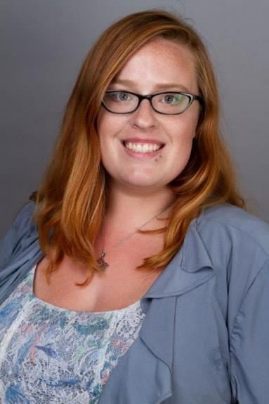
3L Representative
Michaela Martin

Slide 14
ABA Representative

Slide 15
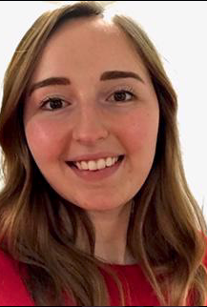
ABA Representative
Samantha Walker

Slide 16
Historian

Slide 17
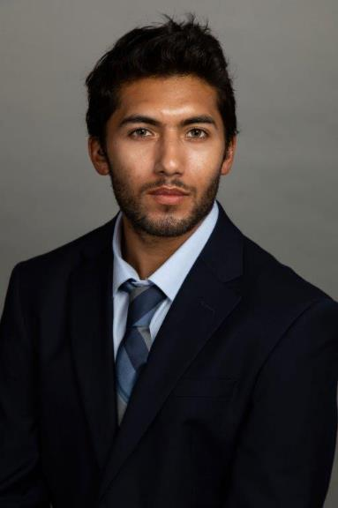
Historian
Jacob
Castrejon

Slide 18
Activities Coordinators

Slide 19
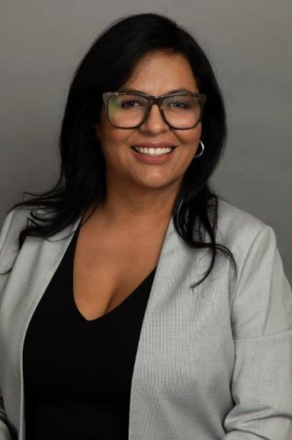
Activities Coordinators
Kissy
Martinez

Slide 20
Activities Coordinators
Chantel Moreno

Slide 21
Secretary

Slide 22
Secretary
Jasmine Robinson

Slide 23
Vice President

Slide 24
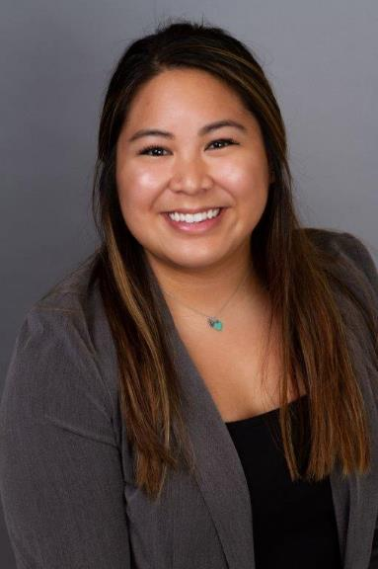
Vice President
Maria
“Nedra”
Cristobal

Slide 25
President

Slide 26
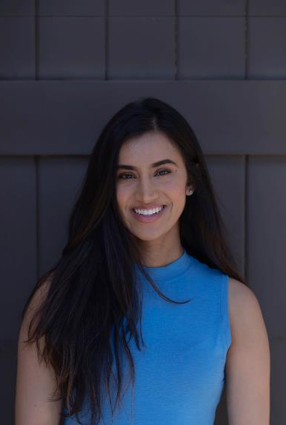
President
Savitri
Zala

Slide 27
Congratulations to the 2021-2022 SBA Board!
President – Savitri Zala
Vice President – Maria “Nedra” Cristobal
Secretary – Jasmine Robinson
Activities Coordinators – Kissy Martinez & Chantel Moreno
Historian – Jacob Castrejon
ABA Representative – Samantha Walker
3L Representative – Michaela Martin
2L Representative – Michael Jurado

Slide 28
Thank you!

